Slide 1





Compliance, Knowledge, Attitudes, and Practices related to Multiple Micronutrient Supplements (MMS) and Micronutrient Powder (MNP) among Pregnant and Lactating Women, Primary Caregivers, and Health Workers in Bhutan
Center of Excellence in Nutrition (CoEN)
Faculty of Nursing and Public Health
Khesar Gyalpo University of Medical Sciences of Bhutan

Slide 2
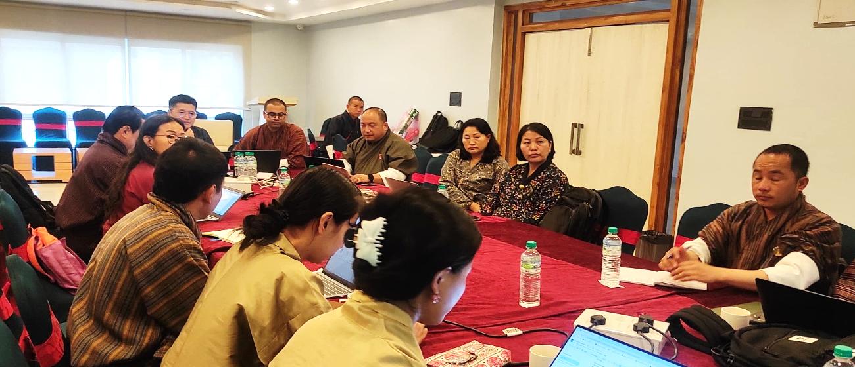
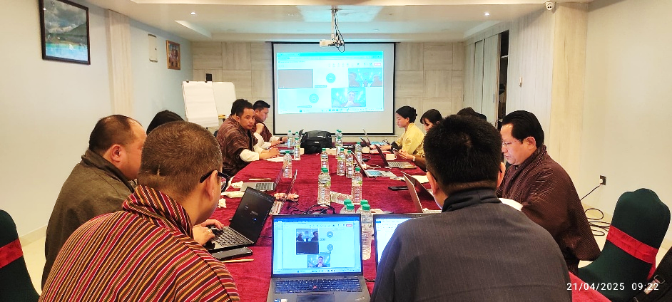
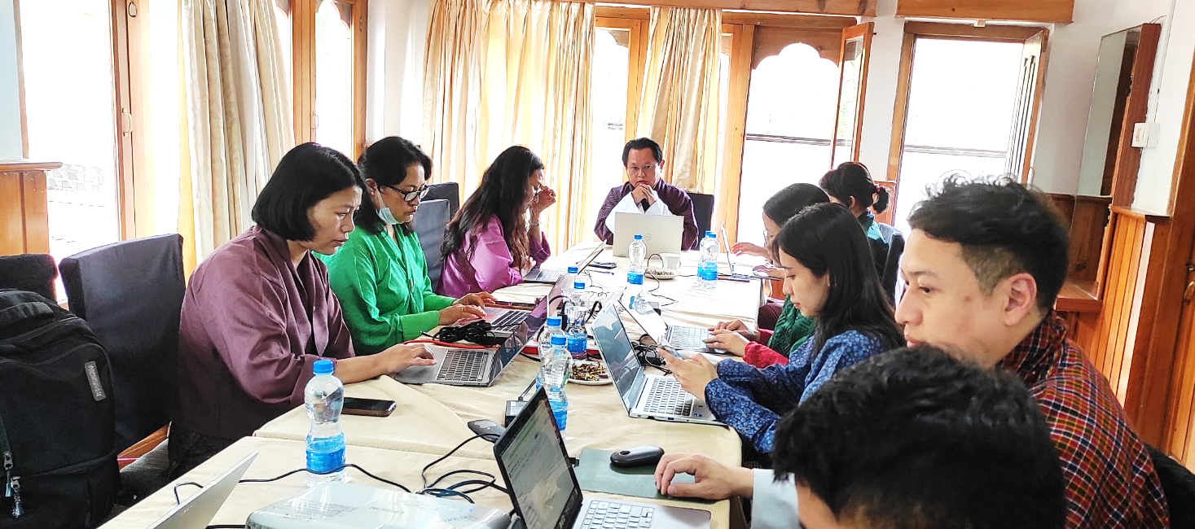
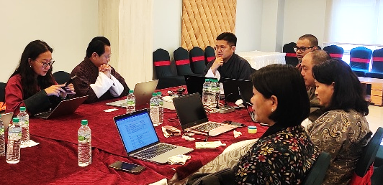
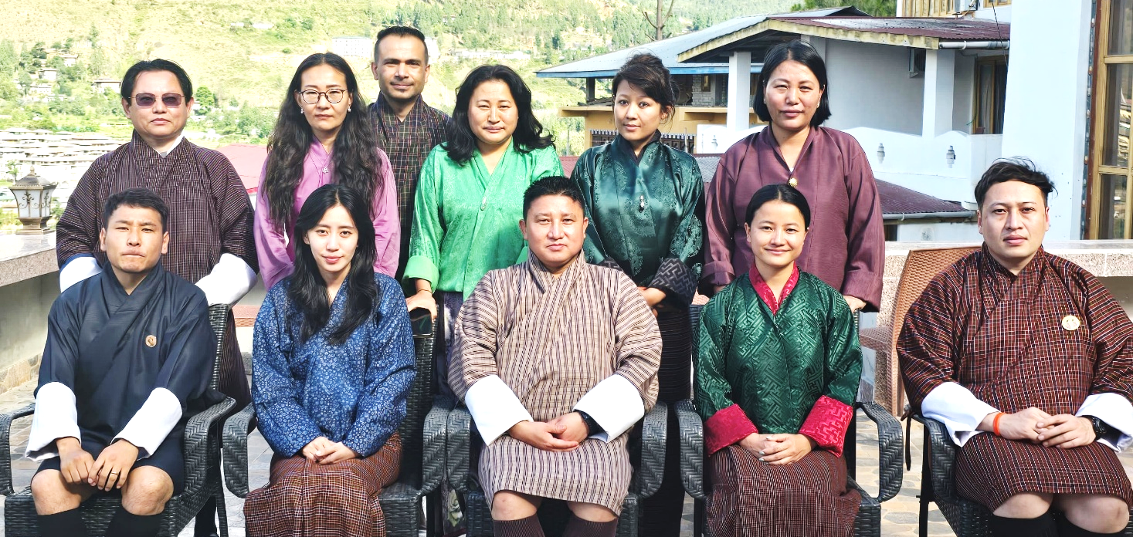
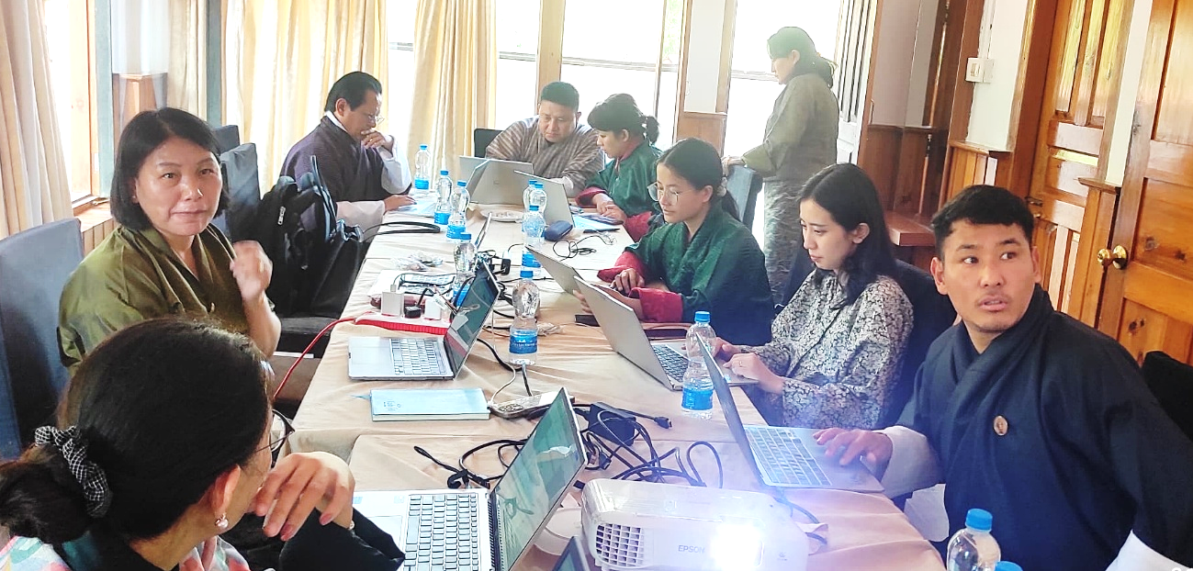
WORKING GROUP

Slide 3
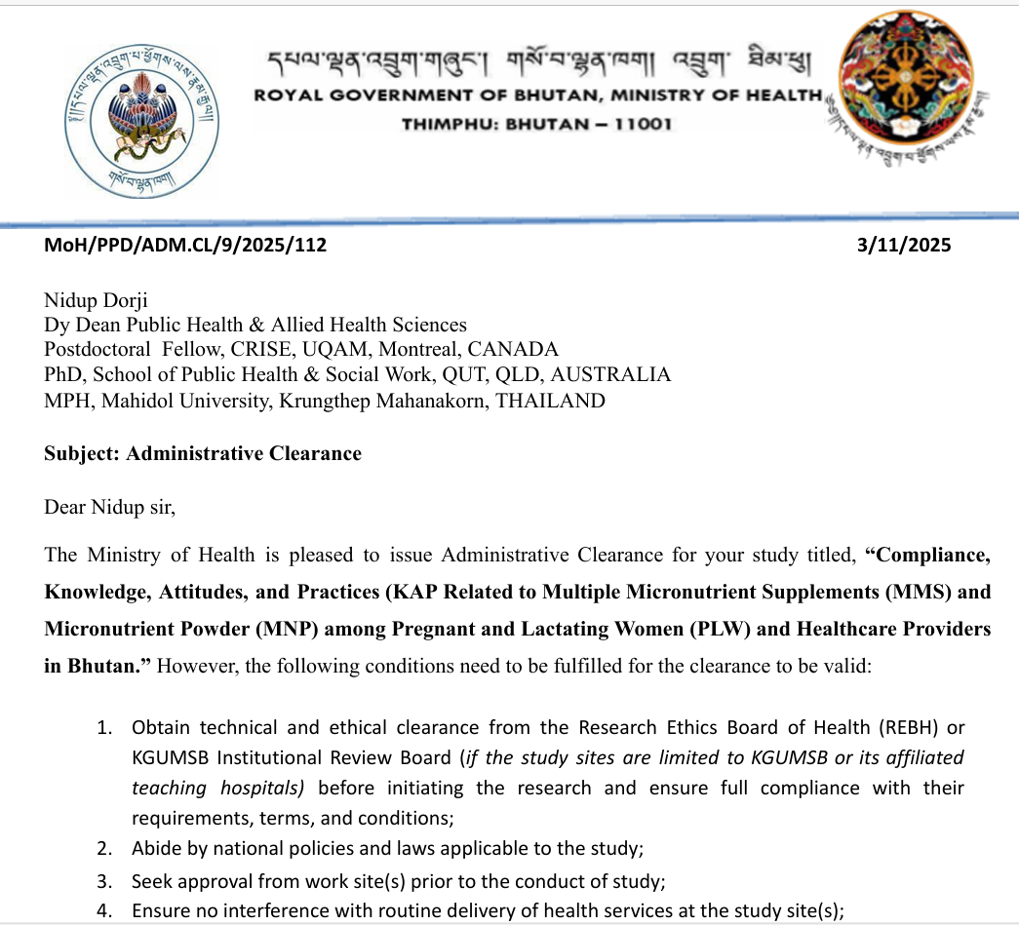
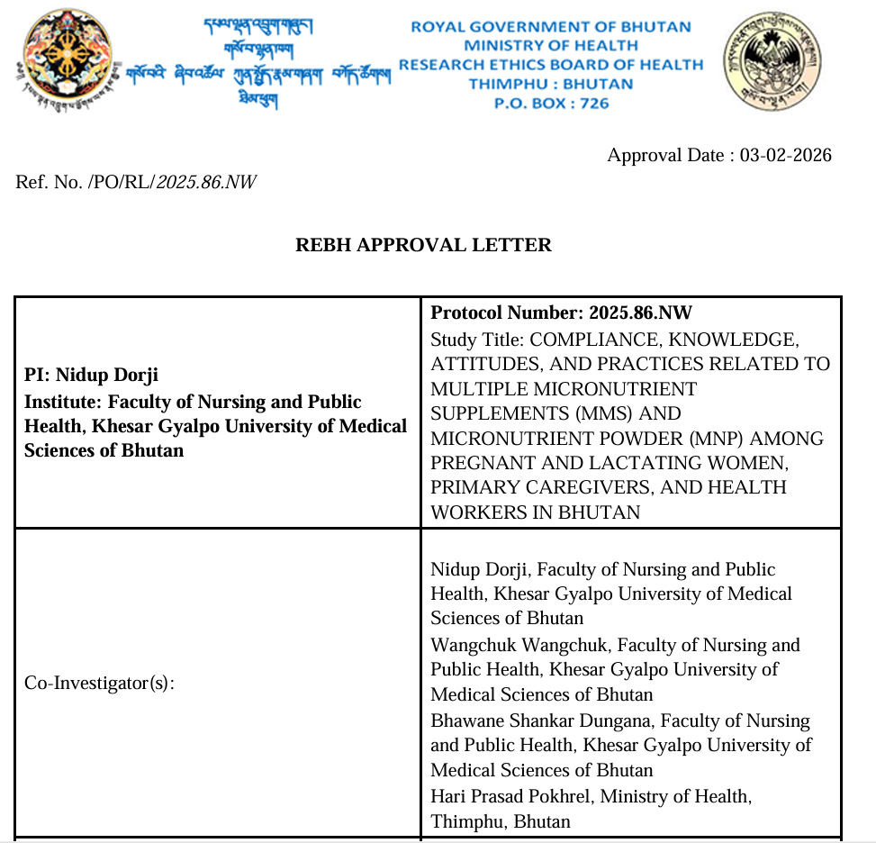
Ethical & administrative clearances
Administrative Approval, Policy & Planning Division (PPD), Ministry of Health
(MoH/PPD/ADM.CL/9/2025/112)
Research Ethics Board of Health (REBH) Approval,
Ministry of Health
(Ref.No./PO/RL/2025.86.NW)

Slide 4

Study Sites
Regions | District | Sample Size | Hospital (n=72) | District Hospitals (10 bedded) & PHCs
Eastern | Trashigang | 142 | Trashigang | Kanglung (n=24) | Ranjung (n=23) | Khaling (n=23)
 | Mongar | 142 | Mongar | Lingmethang (n=24) | Drametse (n=23) | Yadhi (n=23)
 | Samdrup Jongkhar | 142 | Samdrup Jongkhar | Wangphu (n=23) | Samdrupcholing (n=24) | Gomdhar (n=23)
 | Pema Gatshel | 142 | Pema Gatshel | Gonpa Singma (n=23) | Nanong (n=23) | Tsatsi (n=24)
Central | Sarpang | 142 | CRRH | Chokhorling (n=24) | Chuzergang (n=23) | Dekiling (n=23)
 | Wangdue Phodrang | 142 | Wangdue | Kamichu (n=24) | Samtengang (n=23) | Tiki Agona (n=23)
 | Tsirang | 142 | Tsirang | Mendrelgang (n=23) | Dunglagang (n=23) | Semjong (n=24)
 | Dagana | 142 | Dagapela | Nimtola (n=24) | Drujegang (n=23) | Lhajab (n=23)
West | Thimphu | 143 | JDWNRH | Kuzhugchen (n=24) | Genekha (n=23) | Chamgang (n=24)
 | Samtse | 143 | Samtse | Ghumaoni (n=24) | Panbari (n=23) | Dorokha (n=24)
 | Chhukha | 143 | Phuentsholing | Darla (n=24) | Chhukha hospital (n=24) | Gedu hospital (n=23)
 | Paro | 143 | Paro | Drukgyel (n=24) | Betikha (n=23) | Dawakha (n=24)

Slide 5
Data collection Process
Research assistants (RAs)/Enumerators trained
Interviews conducted in Dzongkha, Tshanglakha, Lhotsamkha, or English, based on participant preference.
Used structured interview-administered questionnaire during survey using Research Electronic Data Capture (REDCap) on Android tablets.

Slide 6
Data Management & Analyses
Data collected electronically via REDCap will be exported to Stata format/SPSS (Version 22) for cleaning, validation (including imputation where necessary), and analyses.
Both descriptive and inferential statistical analyses will be performed.
Univariate analysis will be performed: Frequency, percentage, mean, median and standard deviation, range will be calculated to describe the study variables.
Inferential statistical tests: correlations, regression, t-test, analysis of variance tests will be employed to find the relationship between the variables.
A p-value of less than 0.05 will be considered significant throughout the analysis.

Slide 7
What Babies Know 2.0
A Cross-Cultural Eye-Tracking Study in 5 Countries
Bhutan
Japan
Malaysia
Sweden
Uganda
Uppsala University · International Collaborators

Slide 8
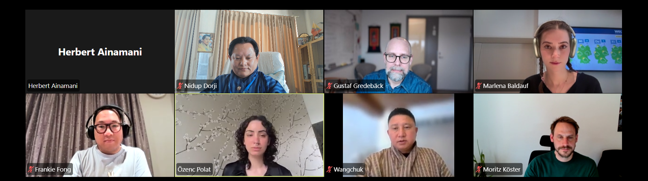
Project: What babies know?
Country | Data collection beginning | Duration | n
Bhutan | September 2026 | 8 months | 200
Sweden | October 2026 | 18 months | 200
Uganda | November 2026 | 4 months | 400
Malaysia | February 2027 | 12 months | 200
Japan | May 2027 | 12 months | 200
Nidup Dorji
Wangchuk

Slide 9
Hypotheses
What we expect to find — and what we acknowledge we might be wrong about
H1
Physical cognition & basic gaze following are experience-expectant
Develop early (before 4 months) and will be universal, independent of cultural background, parental investment, or adversity.
H2
Advanced social cognition is experience-dependent
Goal understanding and pro-sociality will be influenced by parent-child interaction quality and parental investment.
H3
Developmental trajectory changes
Two possibilities: (A) early experience-expectant bootstrapping gives way to experience-dependency, OR (B) Heckman model — early plasticity decreases as capacities consolidate.

Slide 10


