Slide 1


Identification of Aetiological Agents Causing Acute Undifferentiated Febrile Illness in Bhutan
An cross sectional study collaboration between Khesar Gyalpo University of Medical Sciences of Bhutan and Seoul National University Hospital, Republic of Korea

Slide 2
Research Objectives
01
02
Describe Sociodemographic and Clinical Profile
Determine Causative Agents
Characterize patients presenting with AUFI across 12 sentinel sites
Identify infectious aetiologies through comprehensive testing
03
04
Validate Test Results
Generate Spatial and Temporal Mapping
Compare RCDC Bhutan testing with Seoul National University Hospital international reference laboratory
Create heat maps of causative agent distribution across geographic regions

Slide 3
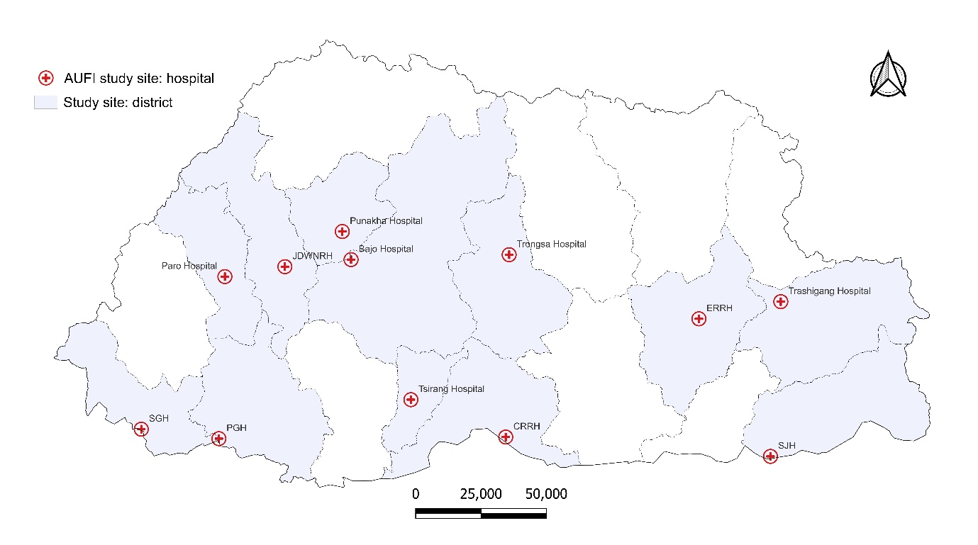
Study Setting and Population
Geographic Coverage
12 sentinel sites representing Bhutan's 20 districts, focusing on sub-tropical southern belt where febrile illness incidence peaks during summer months (June-September)

Slide 4
Target Population
Patients ≥5 years presenting with fever in past 2 weeks with axillary temperature ≥37.5°C
Exclusion Criteria
Obvious localizing causes (pneumonia, abscess, UTI, cellulitis)
Fever attributable to malignancy or immune disorders
Surgical site infections
Patients declining consent

Slide 5
Sampe Size and Sentinel Sites
12
1083
541K
Sentinel Sites
Expected Cases
Total Caseload
Based on 2023 data showing 108,282 patients visited sentinel sites with 10,828 fever cases, approximately 10% meeting AUFI definition ( JDWNH Annual Report 2023). Sites include referral hospitals (JDWNRH, ERHH, CRRH), general hospitals (PGH, SGH, SJH), and district hospitals (Tsirang, Wangdue, Paro, Punakha, Trashigang, Trongsa)

Slide 6



Testing Methodology
Local Hospital Collection
RCDC Thimphu Testing
SNUH Seoul Analysis
EDTA vial (2 mL) + 2 serum vials (4 mL each)
6 agents: dengue, scrub typhus, leptospirosis, chikungunya, JE, brucellosis
Molecular testing: Anaplasmosis, Ehrlichiosis, Bartonellosis, Chlamydia, Legionella, Q-fever, Flavivirus, babesiosis, influenza, RSV, adenovirus, parainfluenza, metapneumovirus, rhinovirus

Slide 7
Expected Findings
Comprehensive Aetiology Profile
Test Performance Validation
Geographic Hotspots
Spatial mapping identifying high-incidence regions for targeted public health interventions
First complete summary of infectious agents causing AUFI in Bhutan beyond current 6-test panel
Sensitivity and specificity comparison between RCDC rapid tests and SNUH molecular diagnostics

Slide 8



Collaborative Partners
Khesar Gyalpo University of Medical Sciences of Bhutan
Seoul National University Hospital, South Korea
Royal Centre for Disease Control, Bhutan
Prof. SeungHwan Lee, Department of Clinical Pharmacology and Therapeutics
Mrs. Suna Jo, Department of Clinical Pharmacology and Therapeutics
Mr. Chimi Dorji, Head/Specialist II, RCDC
Mr. Kezang Wangchuk, DCLO, RCDC
Mr. Dorji Tshering, Sr. Laboratory Technician, RCDC
Mr. Rixin Jamtsho, Director, MECRIT
Mrs. Tshering Choden, Asst.RO, MECRIT

Slide 9
Timeline and Deliverables
Jul-Aug 2025
1
Ethics approvals (REBH, MTA, RCDC)
2
Aug-Sep 2025
Focal person training, REDCap setup
Oct 2025 – Dec 2026
3
Data collection, sample shipment
4
Jan-Mar 2027
Data analysis, manuscript preparation
2027
5
Publication, conference presentations

Slide 10

Impact and Policy Implications
Enhanced Surveillance
Diagnostic Expansion
Prevention Strategies
Strengthen existing AUFI surveillance system at RCDC sentinel sites
Guide introduction of additional diagnostic tests based on identified aetiologies
Inform infectious disease prevention and treatment guidelines for Bhutan
Expected outcomes: Baseline data for evidence-based planning, improved empirical therapy for infectious diseases, hotspot identification for resource allocation, validation of rapid diagnostic tests, and enhanced laboratory capacity through international collaboration.
Funding: International Network for Infectious Diseases (INID-K), Seoul National University through Memorandum of Understanding signed May 2021, renewed 2025

Slide 11
References
Jigme Dorji Wangchuck National Referral Hospital. Jigme Dorji Wangchuck National Referral Hospital Annual Report 2023. Thimphu: Jigme Dorji Wangchuck National Referral Hospital; 2024.

Slide 12
Thank You

