Slide 1



Identification of aetiological agents causing Acute Undifferentiated Febrile Illness in Bhutan: an observational study
International Network for Infectious Disease Research & Development of Korea (INID-K)
Since May 2021
MECRIT, KGUMSB
RCDC, KGUMSB

Slide 2
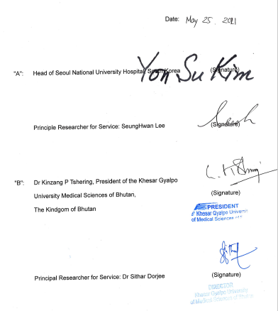
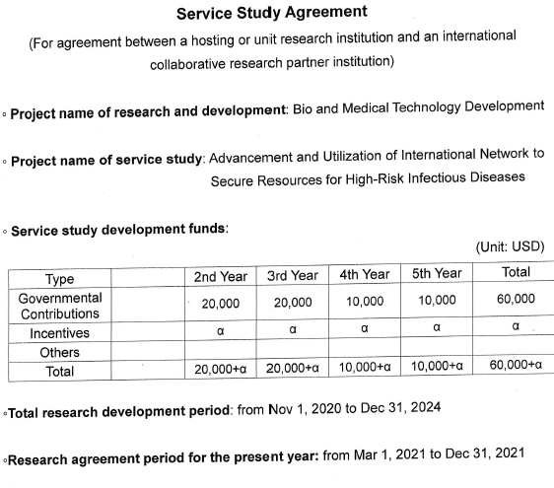
First MoU for the research collaboration was signed in May 2021 between South Korea National University Hospital (SNUH) and KGUMSB

Slide 3
Primary Objectives of the Study:
Advancement and utilization of the international network to secure resources for high risk infectious diseases through existing Acute Undifferentiated Febrile Illness (AUFI) surveillance system managed by the Royal Centre for Disease Control (RCDC), Thimphu.

Slide 4
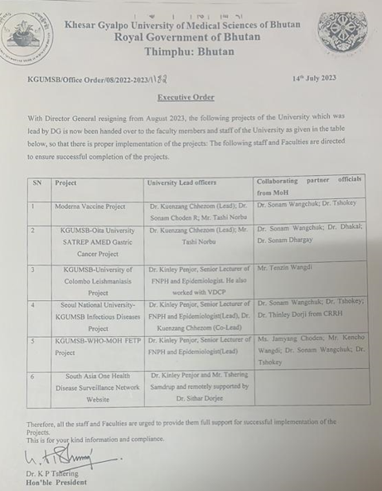
Project was handed over to Dr Kinley Penjore, when Dr Sithar resign from August, 2023.

Slide 5
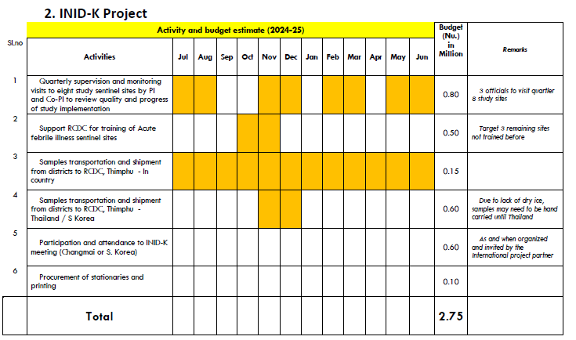
REBH clearance could not be obtained due to MTA issues despite immense effort by the previous team

Slide 6
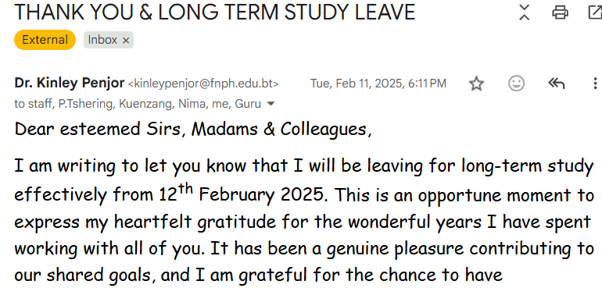
Project was handed over to MECRIT Director, when Dr Kinley Penjore Left for his study in February 2025.

Slide 7
Activities Implemented after handing over to MECRIT Director:
1. First Inception Meeting was convened on 12th May 2025.
2. Developed study protocol and submitted for MTA Approval.
3. Service agreement signed by KGUMSB and sent to INID-K Team.
3. Meeting of the INID-K Project focal Persons.

Slide 8
Recommendations and Decisions of the Inception meeting on 12th May 2025
The contract will be signed after getting ethics approval for AUFI protocol and the Material Transfer Agreement approved as per the procedures laid out in National Guidelines for Transfer of Human Biological Materials, 2024 issued by the Ministry of Health
Dr Thinley Dorji, CRRH, has been nominated as the Principal Investigator and MECRIT will oversee the overall project management.
With regard to the proposal to introduce PCR testing for scrub typhus in selected hospitals in Bhutan where there are already RT-PCR capabilities is available, the Bhutan team will provide the specifications and quantity of test kits required for real time PCR so that the team from Korea can ship the test kits. In return, a part of the positive specimen is to be transported to South Korea.
On Prof Lee’s suggestion on including the testing for influenza to be included as a part of the AUFI protocol, RCDC suggested a discussion between the KGUMSB and RCDC.
Bhutan team to provide details on the data collection sites
Bhutan team to assess the possibility of getting dry ice so that specimens can be shipped directly from Bhutan
On project management and HR support, the following decisions were made:
Project assistant to be recruited using the project fund for salary.
A quarterly meeting shall be conducted with focal persons from the participating hospitals
Participating hospitals to designate a dedicated focal person for this project.
Prof Lee and team make a visit to Bhutan to monitor the progress.

Slide 9
Way forward
1. Push MTA approval and REBH Clearance by core study team
2. Conduct monthly and quarterly meeting
3. Confirm the list of AUFI Focal person for the INID-K Project
4. Identify RCDC Chief as one of the co-investigator
5. Invite principal Investigator from INID-K to Bhutan.
6. Confirm the study sites along with AUFI sites.

Slide 10
THANK YOU

